Slide 1
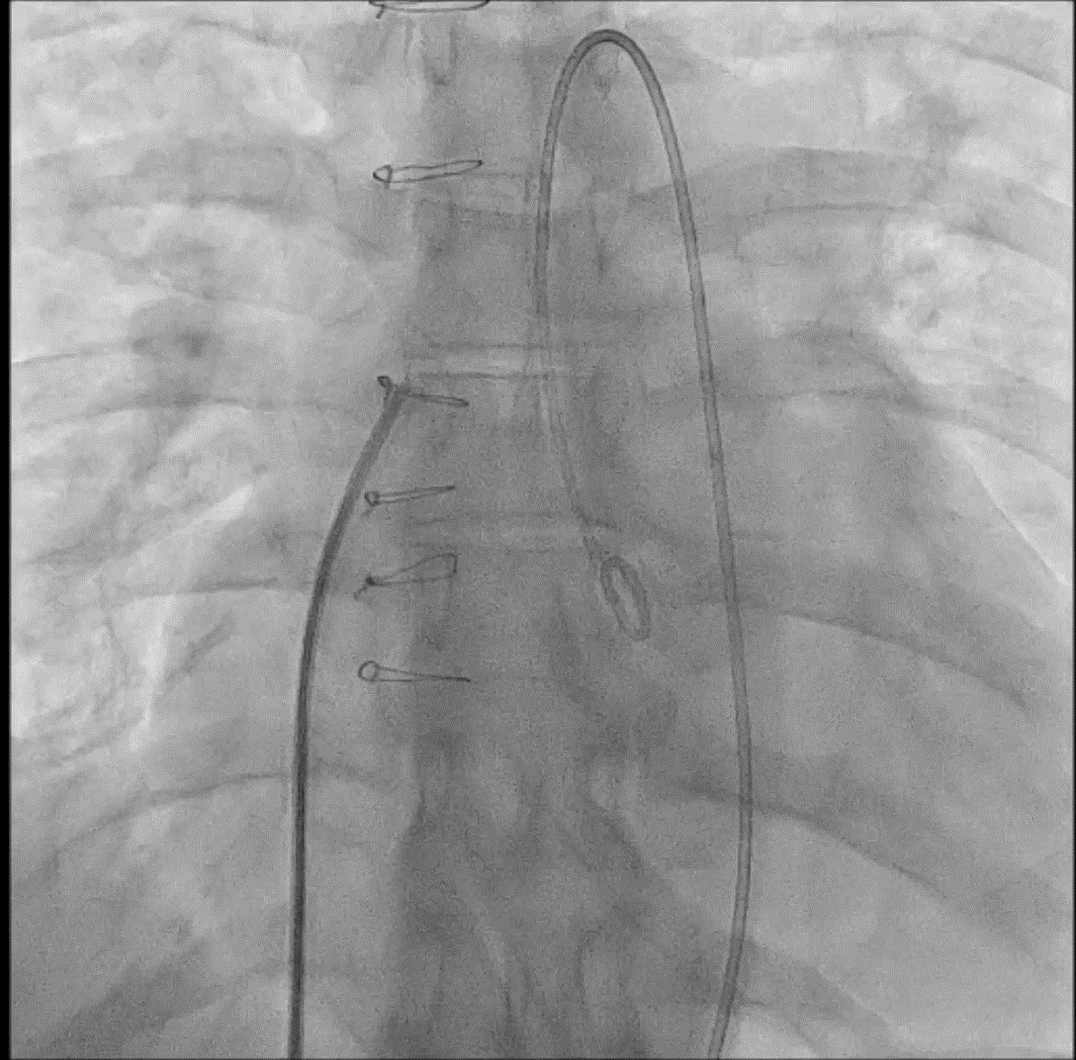
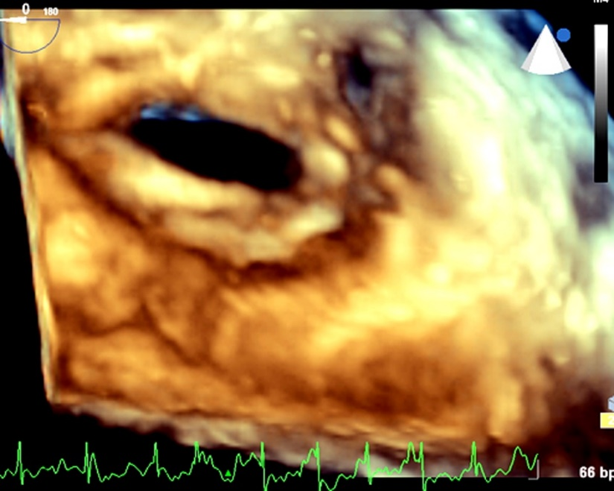
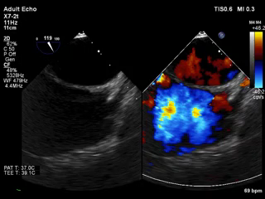
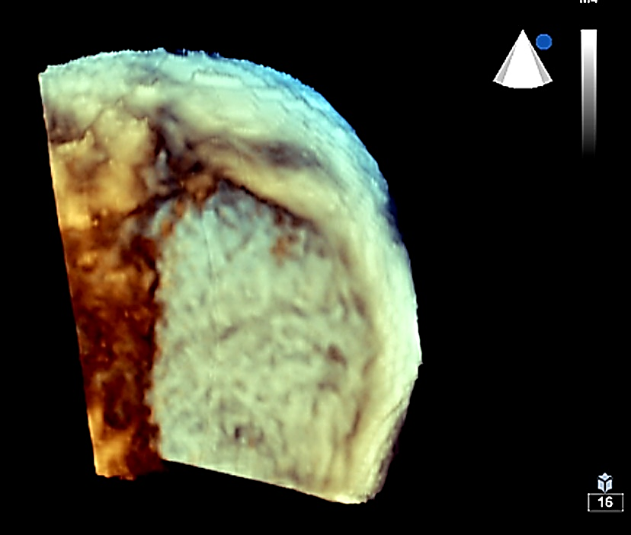
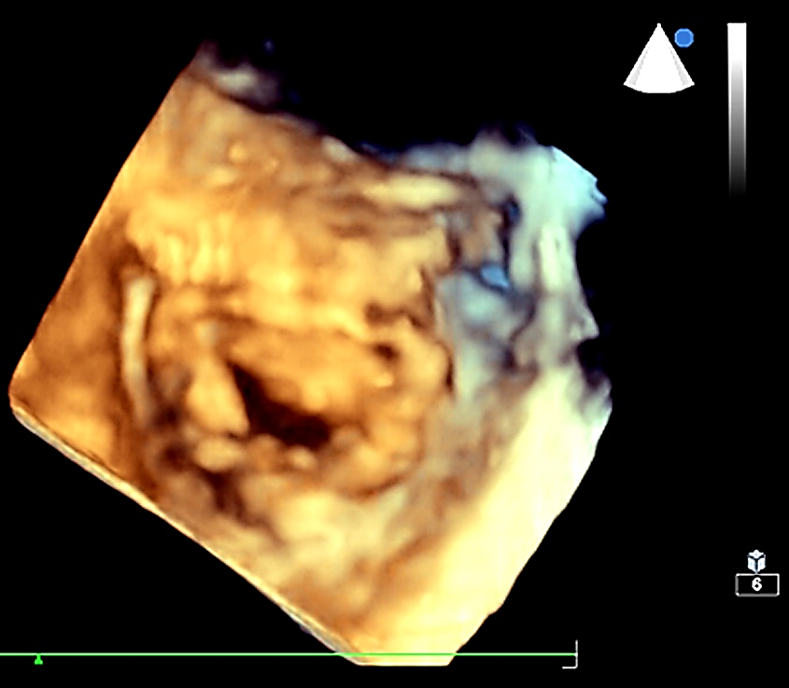
Percutaneous transvenous mitral commissurotomy (PTMC) in a postoperative patient who had pericardial patch repair of the atrial septal defect (ASD).
47-year-old female with severe mitral stenosis (MS) and post ASD patch repair, for PTMC.
Thickened pericardial patch at atrial septum and fish-mouth appearance of MS.
PTMC through pericardial patch.
Successful crossing of atrial septum during PTMC
Successful dilatation of mitral valve, with iatrogenic ASD across pericardial patch
Favorable 6-months of follow-up with disappearance of iatrogenic ASD
[Vijayvergiya R] et al. Innovations. [Month/Month Year].
@Innovationsjour | Copyright © The Author(s) [YEAR]. All rights reserved. Published by SAGE Publishing Inc.

